Slide 1
Meet The Team
We are a group of B.Tech students currently pursuing our degree at Vellore Institute of Technology, Chennai. Our team is passionate about artificial intelligence and machine learning, and we have developed a solution that can help farmers detect weed in their fields. Our solution is based on deep learning and image processing techniques. We believe that our solution can help farmers save time and resources by identifying weed patches in their fields more efficiently. We are excited to continue exploring the world of AI and ML and make a positive impact on society with our work
Kushagra Borse
Ninad Sugandhi
Spandan Mukherjee
Gayatri Joshi

Slide 2
Problem Statement (short description in about 100 words)
Assumptions
The problem statement for weed detection and removal in farm fields is to accurately identify the area of weeds so that specific areas can be targeted for spraying with minimum spraying on the other plants of interest. Once the weed patches are identified, farmers can use various methods such as mechanical weeding or chemical weeding to remove the weeds.
The image captured from the camera should not contain any motion blur.
The camera should be placed at such a height that it captures top view of the plant(leaves visible).
The system works well when the frame captured is well lit and sharp.

Slide 3
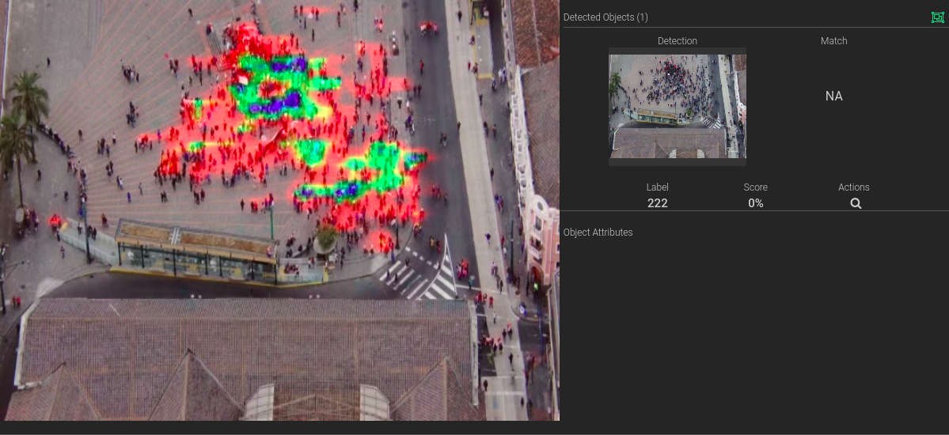
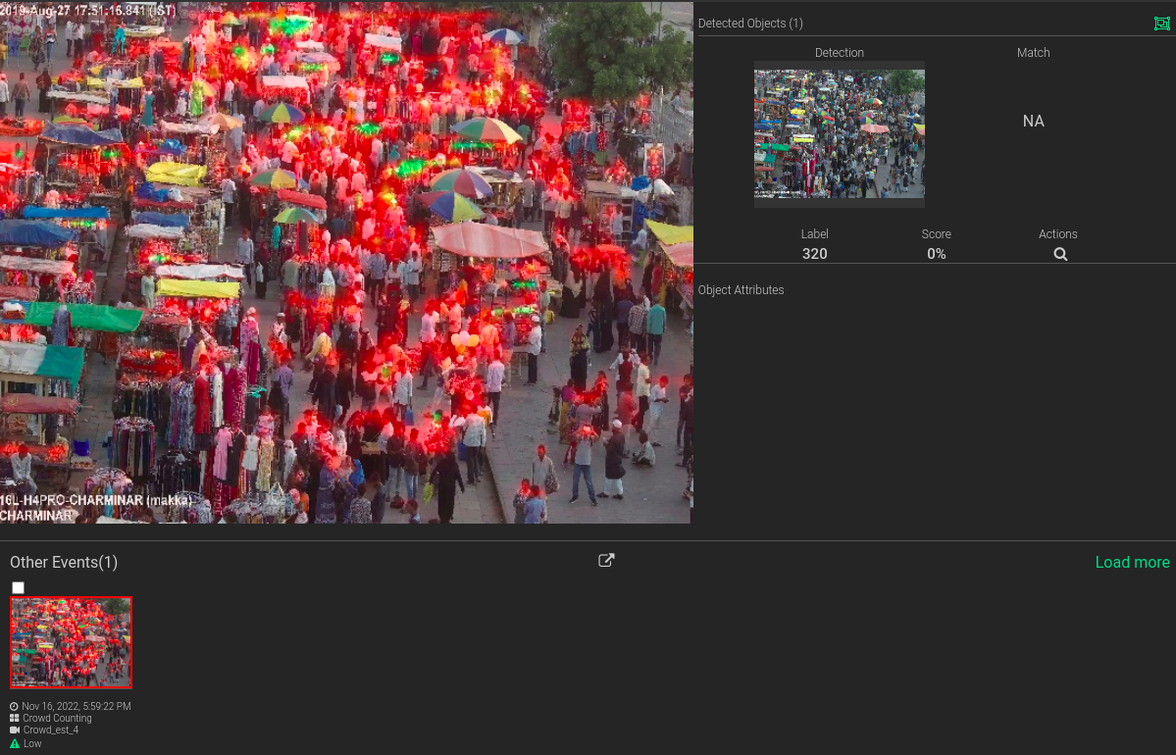
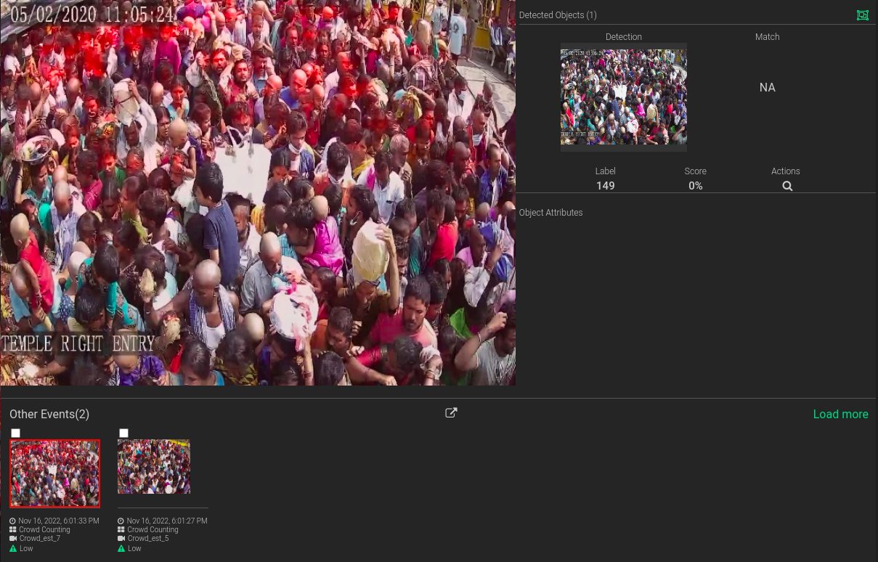
Weed detection in action
Link to the video – https://youtu.be/ps3-sGOF6-0

Slide 4
Our Approach
 | App Logic
01 | Livestream from cameras
02 | Identify weed and crops in FOV
03 | Alert the farmer when weed is detected
Weed detection app
Objective:
To find and identify weeds in a farm in real-time from video feeds.
Maximizing crop yield by identifying and managing weeds effectively. Reducing resource usage (e.g., water, fertilizers, herbicides) by applying them more selectively. Enhancing environmental sustainability by minimizing the use of chemicals and reducing pollution.
Key Features:
Video Feed Integration:
Access live video feeds from surveillance cameras or smartphones.
Weed detection model:
Implement yolov8 based weed detection model.
Technology Stack:
Python, OpenCV, TensorFlow, Yolov8

Slide 5
Details about the models
 | Model Name | Model Type | Framework | Input Format and Shape | Output Shape | Custom Tweaks
Primary Model Architecture | Yolov8 | Object detection and identification | Yolo | 512 X 512 color image. Labels for images are in YOLO format. | 512 x 512 | NA

Slide 6
Thank You

